Slide 1


Team 54: Remote Thermal Viewing within High Voltage
Bi-Weekly Update 2 Blake Bagley, Julia Garcia, Erica Mathew Sponsor: Powell Industries TA: Vishwam Raval
Notes:
Michelle

Slide 2
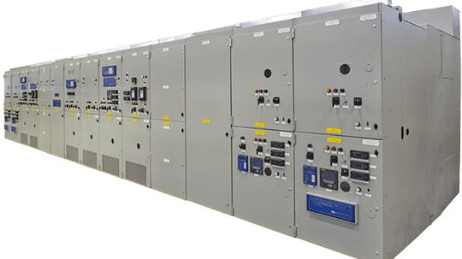

Project description
Problem statement: “As industry demand grows, space inside medium voltage switchgear has become increasingly limited. Manufacturers are required to fit more devices and wires within the same limited space. Additionally, manufacturers are now being asked to include a remote viewing system within the switchgear to monitor a physical ground switch. This ground switch is physically blocked, by wires, from the view of the operator.”
Notes:
Erica: Our project sponsor is powell industries which is a “Powell Industries designs and manufactures equipment like switchgear, circuit breakers, and power management systems that help safely control and distribute electrical power in multiple different industries
Switchgears are Switchgears are devices that control and protect electrical circuits by turning power on or off and preventing damage during electrical faults.
Powell industries designs/maufactures
explain switchgears
explain project

Slide 3
System Overview
Power Supply
Thermal Sensor
Battery
Website
Converters
Microcontroller
Julia, Blake, Erica
Notes:
Julia: Design the power supply and overall hardware of the system.
Blake: Microcontroller coding and ML
Erica: Creating Web Application for users to interact with

Slide 4
Project Timeline
Update #1: Designed and ordered new PCB + started integrating Microcontroller/Website | Update #2: Have PCB soldered and tested + Website/Microcontroller connection | Update #3: Have PCB working and have microcontroller programmed + switch state communication | Update #4: All Integration between subsystems complete | Update #5: Practice Demo + Completing Final Report + Preparing for Showcase
Notes:
Eric

Slide 5
Subsystem 1: PCB
Julia
Accomplishments since last update 10 hrs of effort | Ongoing progress/problems and plans until the next presentation
All buck converters soldered All converters tested 3/4 are functional Completed in preparation for integration with microcontroller subsystem | Replace non-functional converter Solder the ESP32 onto the board in preparation for integration with microcontroller subsystem Solder camera socket onto board Test ‘communication’ with ESP32 using oscilloscope

Slide 6
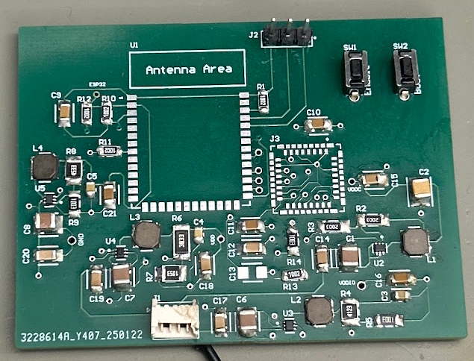
Subsystem 1: PCB
Julia
3 buck converters functional
Tested using DC power supply
Voltage in: ~3.7 V
ESP32
Expected: 3.3 V
Measured: 0.04 V
VDD
Expected: 2.8 V
Measured: 2.804 V
VDDIO
Expected: 3.1 V
Measured: 3.061 V
VDDC
Expected: 1.2 V
Measured: 1.205 V
Once the ESP32 and camera socket are soldered onto the board, integration can begin with microcontroller subsystem.

Slide 7
Subsystem 2: Microcontroller
Blake
Accomplishments since last update 17 hrs of effort | Ongoing progress/problems and plans until the next presentation
Found and learned API for communication ("esp_http_client.h") The microcontroller successfully connects to website and can communicate | Next is looking into specific image formatting to send images to the website

Slide 8
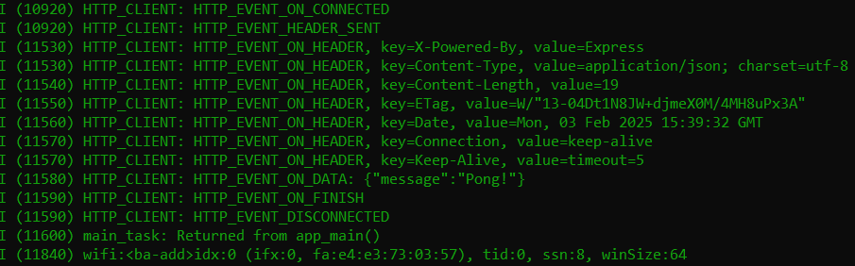
Subsystem 2: Microcontroller
Blake
Proof of connection and communication

Slide 9
Subsystem 3: Website
Erica
Accomplishments since last update 15 hrs of effort | Ongoing progress/problems and plans until the next presentation
Achieved connectivity between the microcontroller and website The website successfully received a HTTP POST request from the microcontroller | We are now working on encoding the images creating a system to send/receive the images one by one

Slide 10
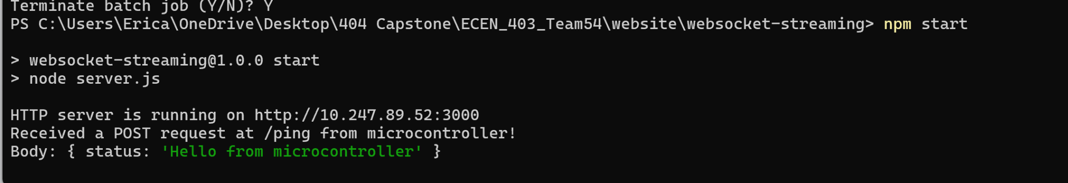
Subsystem 3: Website
Erica
Successful Connection:

Slide 11
Execution plan
 | 1/20/25 | 1/27/25 | 2/3/25 | 2/10/25 | 2/17/25 | 2/24/25 | 3/3/25 | 3/10/25 | 3/17/25 | 3/24/25 | 3/31/25 | 4/7/25 | 4/14/25 | 4/21/25 | 4/28/25
PCB Updated
Updated PCB ordered
Parts Ordered
Researched Integration
Microcontroller Code Modified
Website Code Modified
Status Update #1
New boards soldered
Verify Server can receive data from microcontroller
Buck converters tested
Website and Microcontroller Connection
UHMW Polyethylene sheet ordered |  |  |  |  |  |  |  |  | Not Started
Status Update #2 |  |  |  |  |  |  |  |  | In Progress
MCU and Website communication tested |  |  |  |  |  |  |  |  | Completed
PCB and Microcontroller Integration |  |  |  |  |  |  |  |  | Behind
UHMW Polyethylene Box made
MCU and Website Communicate Switch State
Dielectrics Testing
Status Update #3
Website and Microcontroller Fully Integrated
Full System Integration
Status Update #4
Troubleshoot any issues
Practice Demo
Status Update #5
Final Presentation
Final Demonstration
Final Report

Slide 12
Thank you for listening!

